Slide 1
Exploring Mode Effect Adjustment Approaches for a Web and Face-to-Face Survey
Joint Statistical Meetings 2024
08.04.2024
Brian M. Wells, Sara Lafia, Martha McRoy

Slide 2
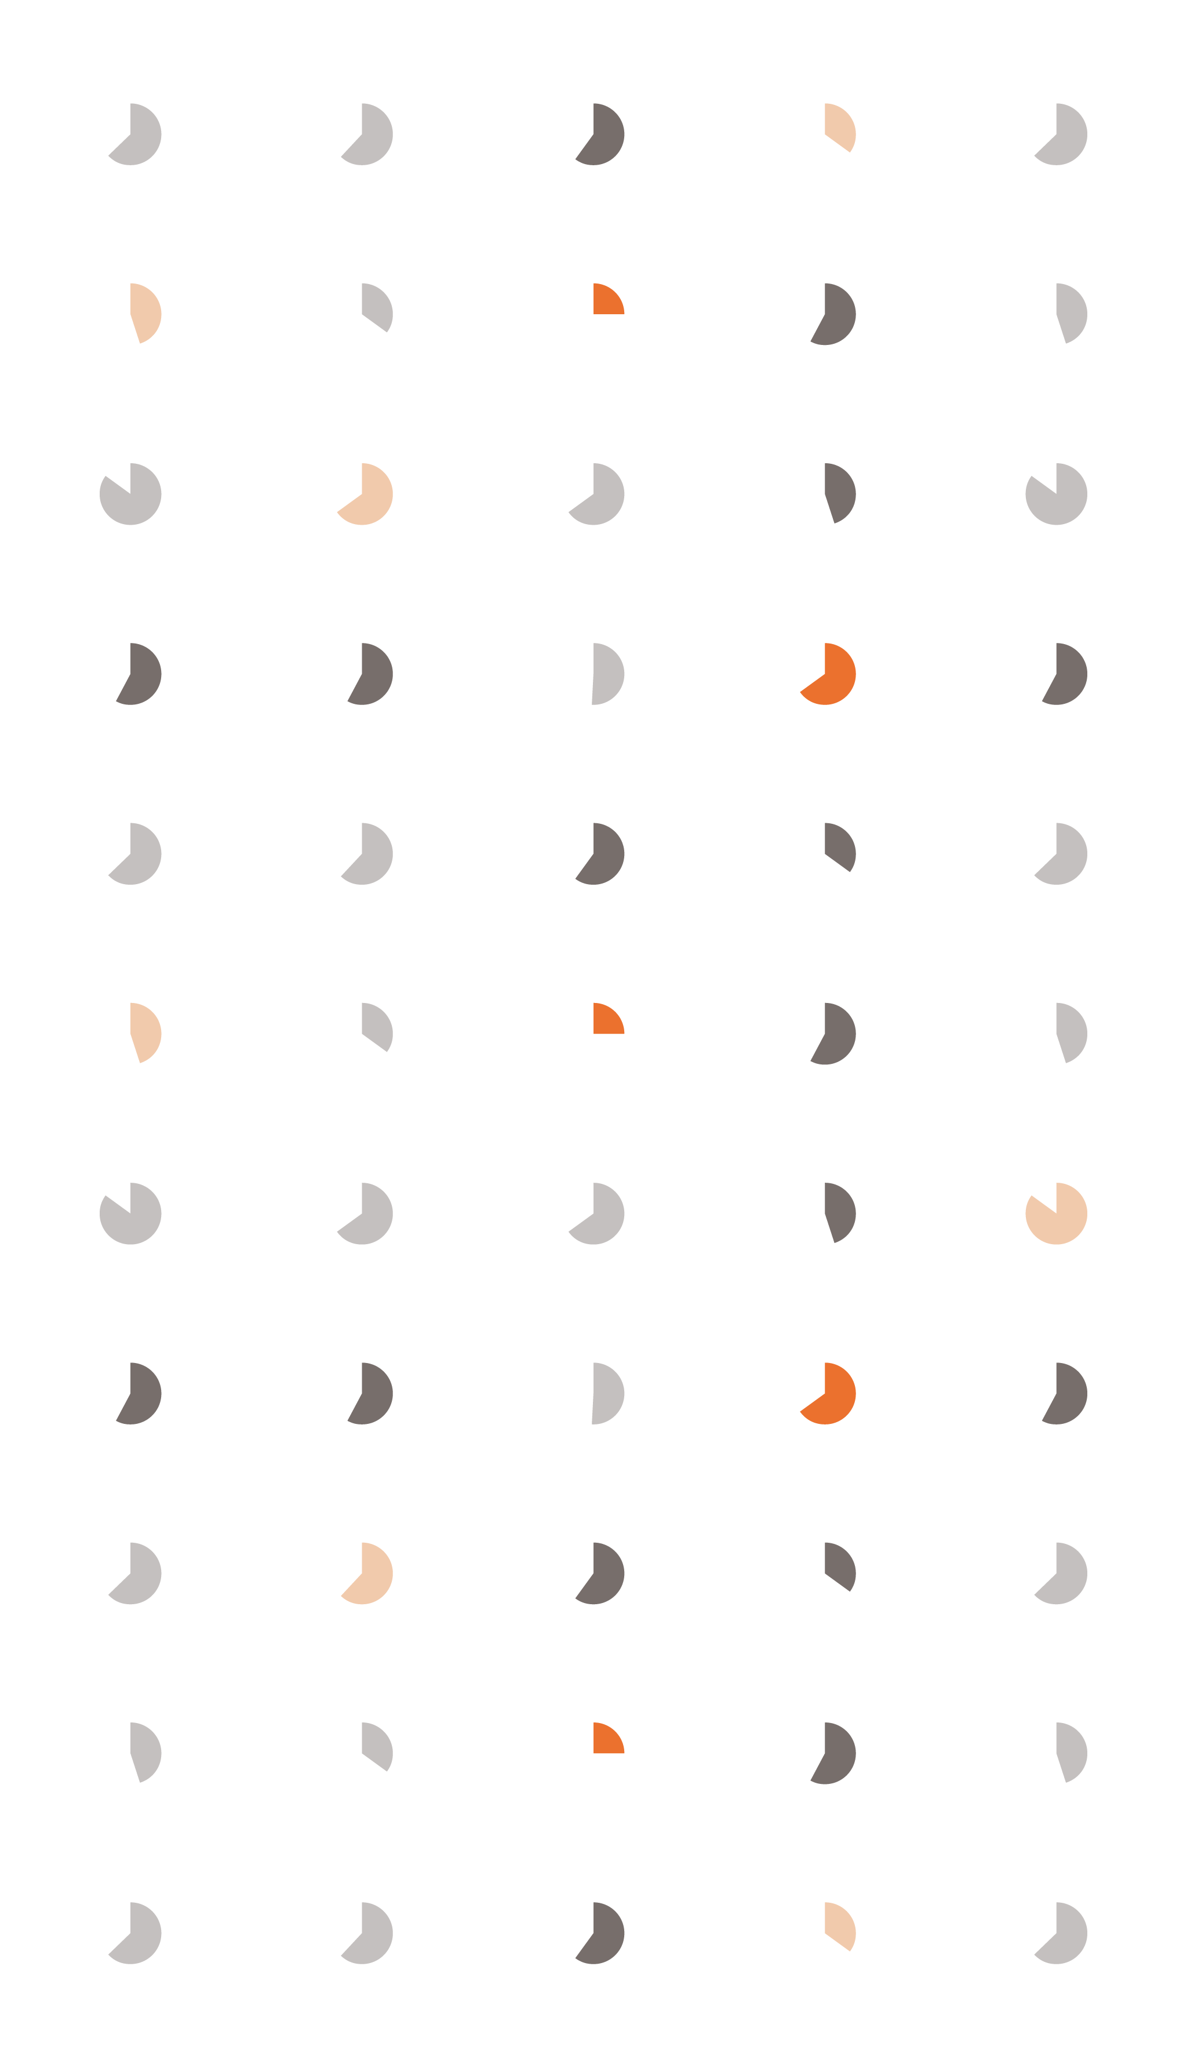
Agenda
 | Agenda
01 | Mixed-Mode Surveys
02 | Mode Effect Adjustments
03 | Variable-Level Adjustments
04 | Weight-Level Adjustments
05 | Conclusions

Slide 3
Mixed-Mode Surveys
Background

Slide 4
Mixed-Mode Surveys : Modes of Surveys
Mixed-mode surveys allow respondents to participate in the survey mode that’s right for them.
Self-Administered Modes:
Computer Assisted Web Interviewing (CAWI)
Paper and Pencil Interviewing (PAPI)
Interviewer-Administered Modes:
Computer Assisted Telephone Interviewing (CATI)
Computer Assisted Personal Interviewing (CAPI)
Mixed mode surveys can reach different populations but can have their own challenges.
Interviewer effects
Mode effects
Notes:
Many different modes to complete a survey, and each has advantages and disadvantages.
Using mixed-mode surveys, people can participate in which mode works best for them.
Allows other populations to be reached, such as the offline population.
Certain modes are better at gaining cooperation, such as face-to-face survey modes.
Survey modes have shown to impact responses and findings. Some aspects to these include mode effects and interviewer effects.

Slide 5
Mixed-Mode Surveys : Mode Effect Adjustments
Mode effect adjustments can be used to help correct mode effects in mixed-mode surveys.
Variable-level adjustment
Advantage: more precision, control for models
Disadvantage: modeled at estimate level
Kolenikov and Kennedy (2014)
Logistic regression adjustment
Linear regression adjustment
Multivariate imputation by chained equations (MICE) adjustment
Weight-level adjustment
Advantage: universally applied
Disadvantage: potential for unnecessary adjustments for select variables
Brick et al. (2022)
Adaptive mode adjustment
Note: Kolenikov and Kennedy (2014) also explored implied utility-multiple imputation (IUMI) but we do not explore this in this research.
Notes:
One way to combat mode effects for mixed-mode surveys are to use mode effect adjustments.
These can be done for each variable individually, or through a weight-level adjustment.

Slide 6


Mixed-Mode Surveys : Intro to the GSS
For 50 years, the GSS has been used to study social change in the United States.
General Social Survey (GSS)
The GSS is a nationally representative survey that has historically been conducted through face-to-face interviews every two years by highly trained and skilled interviewers.
Covers a wide variety of topics on exploring people’s attitudes, behaviors, and attributes:
Politics, social life, economic life, lifestyle, science, religion, civil liberties, racial perceptions, national spending priorities, parental & social origin, demographics, occupation, etc.
One of the most influential and widely used studies in the social sciences.
Sponsored by the National Science Foundation

Slide 7
Mixed-Mode Surveys : GSS 2022 Overall Design
GSS 2022 Design
NORC National Frame
Adopted a multimode data collection design with both web questionnaires and face-to-face interviews.
Responds to the evolving survey landscape
Addresses rising data collection costs
More efficient, allows for respondent flexibility in how they complete the survey
Allows for larger sample sizes
Opportunities for web-based follow-on studies
Design will be repeated in 2024.
GSS Sample
Target completes=1,400
RANDOMIZATION
Target completes=1,400
Face-to-Face
Push to Web
Mail
Mail
Telephone
Telephone
Face-to-Face Follow-Up
Web
NRFU
Push to Web
Push to Face-to-Face
NRFU
2022 GSS Follow up
(Web only)
Target completes=1,000

Slide 8
Mixed-Mode Surveys : GSS 2022 Mode Differences
Preliminary analyses by the GSS team identified key variables that were more likely to be sensitive to mode.
Reviewed 163 GSS key variables and classified them into three categories:
Likely mode sensitive
Differences of observed predicted probabilities by mode was 10pp or higher for at least one response category
Requires further investigation
Differences were less than 10pp but still high
Less likely to be mode sensitive
We focus our analysis on the 44 variables identified in the first two groups.
These variables are most likely to see the most extreme variables mode differences.
https://gss.norc.org/Documents/codebook/GSS%202022%20Codebook.pdf

Slide 9
Mode Effect Adjustments
Variable Level

Slide 10

Mode Effect Adjustments : Models
Controlling for key demographic variables in our models, mode adjustments were applied to the mode-sensitive variables.
Controlled key demographics
Sex, age, race, ethnicity, educational attainment, marital status, region
Models used:
Logistic regression (mode only; no demographics)
Logistic regression adjustment
Linear regression adjustment
Multivariable imputation by chained equations (MICE) adjustment
Simplified MODE into web/mixed-mode (mostly self administered) and in-person/CATI (interviewer administered)

Slide 11
Mode Effect Adjustments : Demographic Differences
Selection differences by key demographics including education and marital status.
Notes:
In-person/telephone completes seemed to obtain slightly older respondents, more Black respondents than White respondents, more Hispanic respondents, lower educated respondents, and more widowed and divorced respondents.

Slide 12
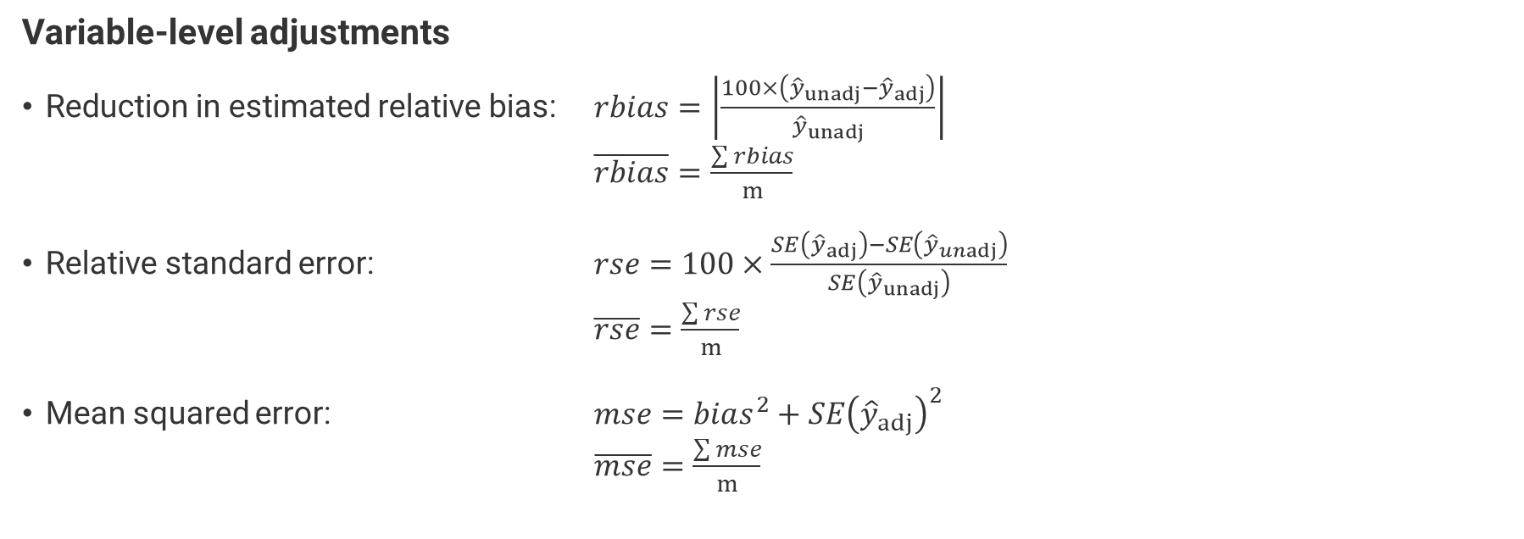
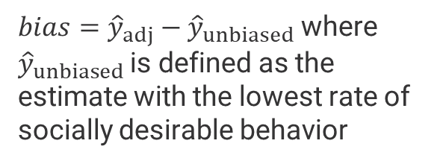
Mode Effect Adjustments : Comparison Metrics
To compare the adjustment techniques, we assess these metrics for our variable-level adjustments.
Variable-level adjustments
Reduction in estimated relative bias: $rbias=\left|\frac{100×\left({\hat{y}}_{unadj}−{\hat{y}}_{adj}\right)}{{\hat{y}}_{unadj}}\right|$ $\overline{rbias}=\frac{\sum{rbias}}{m}$
Relative standard error: $rse=100×\frac{SE\left({\hat{y}}_{adj}\right)−SE\left({\hat{y}}_{unadj}\right)}{SE\left({\hat{y}}_{unadj}\right)}$ $\overline{rse}=\frac{\sum{rse}}{m}$
Mean squared error: $mse=bias^{2}+SE{\left({\hat{y}}_{adj}\right)}^{2}$ $\overline{mse}=\frac{\sum{mse}}{m}$
$bias={\hat{y}}_{adj}−{\hat{y}}_{unbiased}$ where ${\hat{y}}_{unbiased}$is defined as the estimate with the lowest rate of socially desirable behavior
Notes:
Results compared by examining reduction in estimated relative bias, estimated relative standard error, and mean squared error.

Slide 13
Main Findings
Variable-Level Adjustments

Slide 14
Variable Level : SPKRAC
Adjustment | Estimate (SE) | Decrease in relative bias | Increase in relative SE
Without adjustment | 52.2% (3.2) | - | -
Without adjustment (final sample size) | 54.0% (3.3) | - | -
Logistic regression adjustment (mode only) | 61.6% (4.0) | 14.1% | 19.7%
Logistic regression adjustment | 61.1% (5.6) | 13.2% | 68.0%
Linear regression adjustment | 59.5% (2.9) | 10.1% | -13.8%
MICE adjustment | 61.5% (3.6) | 13.9% | 8.3%
SPKRAC
This page is extraneous. PLEASE DELETE and any other relevant template related associations to this page.
All adjusted estimates are higher than the original estimate.
Bigger shifts in relative bias, bigger shifts in relative standard error and mean squared error.
Linear regression adjustment produced the most conservative estimate and decreased the SE.
Note: Face-to-face-first sequence estimates
Notes:
SPKRAC. Consider a person who believes that Blacks are genetically inferior. If such a person wanted to make a speech in your community claiming that Blacks are inferior, should he be allowed to speak, or not? (% Yes)
This question is about freedom of speech, the more socially desirable answer is “yes,” and the bias estimate is based on the “yes” responses before adjustment and “yes” responses after adjustments.

Slide 15
Variable Level : POLABUSE
Adjustment | Estimate (SE) | Decrease in relative bias | Increase in relative SE
Without adjustment | 10.2% (1.6) | - | -
Without adjustment (final sample size) | 10.9% (1.7) | - | -
Logistic regression adjustment (mode only) | 9.0% (2.2) | 18.0% | 33.1%
Logistic regression adjustment | 6.7% (3.2) | 39.1% | 90.9%
Linear regression adjustment | 7.7% (1.8) | 29.6% | 7.6%
MICE adjustment | 11.7% (5.2) | 6.7% | 206.2%
POLABUSE
This page is extraneous. PLEASE DELETE and any other relevant template related associations to this page.
Three adjustments produce estimates lower than the original, while MICE produces a higher estimate.
MICE adjustment increased the relative SE by over 200%.
Note: Face-to-face-first sequence estimates
Notes:
POLABUSE. Are there any situations you can imagine in which you would approve of a policeman striking an adult male citizen? Had said vulgar and obscene things to the policeman? (% Yes)

Slide 16
Variable Level : Overall
Adjustment comparison
Adjustment | Avg. decrease in relative bias | Avg. increase in relative SE
Logistic regression adjustment (mode only) | 11.4% | 18.2%
Logistic regression adjustment | 35.8% | 65.1%
Linear regression adjustment | 26.6% | 83.1%
MICE adjustment | 12.2% | 26.7%
This page is extraneous. PLEASE DELETE and any other relevant template related associations to this page.
MICE adjustment saw the lowest change in relative bias
Linear regression adjustment had the largest increase in relative standard error.
Note: Face-to-face-first sequence estimates
Notes:
POLABUSE. Are there any situations you can imagine in which you would approve of a policeman striking an adult male citizen? Had said vulgar and obscene things to the policeman? (% Yes)

Slide 17
Variable Level : Binary variables Only
Adjustment comparison (binary vars only)
Adjustment | Avg. decrease in relative bias | Avg. increase in relative standard error | Avg. mean squared error
Logistic regression adjustment (mode only) | 8.4% | 11.2% | 11.1%
Logistic regression adjustment | 13.6% | 100.3% | 77.0%
Linear regression adjustment | 10.4% | 21.6% | 45.3%
MICE adjustment | 7.1% | 34.1% | 17.3%
This page is extraneous. PLEASE DELETE and any other relevant template related associations to this page.
Largest shifts in estimates found with logistic and linear adjustments
Average relative SE doubled with the logistic adjustment
Lowest changes in average MSE found for the mode-only and MICE adjustments
Note: Binary variables only. Face-to-face-first sequence estimates

Slide 18
Mode Effect Adjustments
Weight Level

Slide 19
Mode Effect Adjustments : Weight Level
Research is ongoing on using an adaptive mode adjustment in the weights.
Adjustment levels
Online vs offline completion mode
30/70, 40/60, 50/50, 60/40, 70/30
Analyses
Compare new estimates to key benchmarks
Assess impacts of various adjustment levels
Compare weight-level adjustments to variable-level adjustment using same comparison metrics

Slide 20
Conclusions

Slide 21
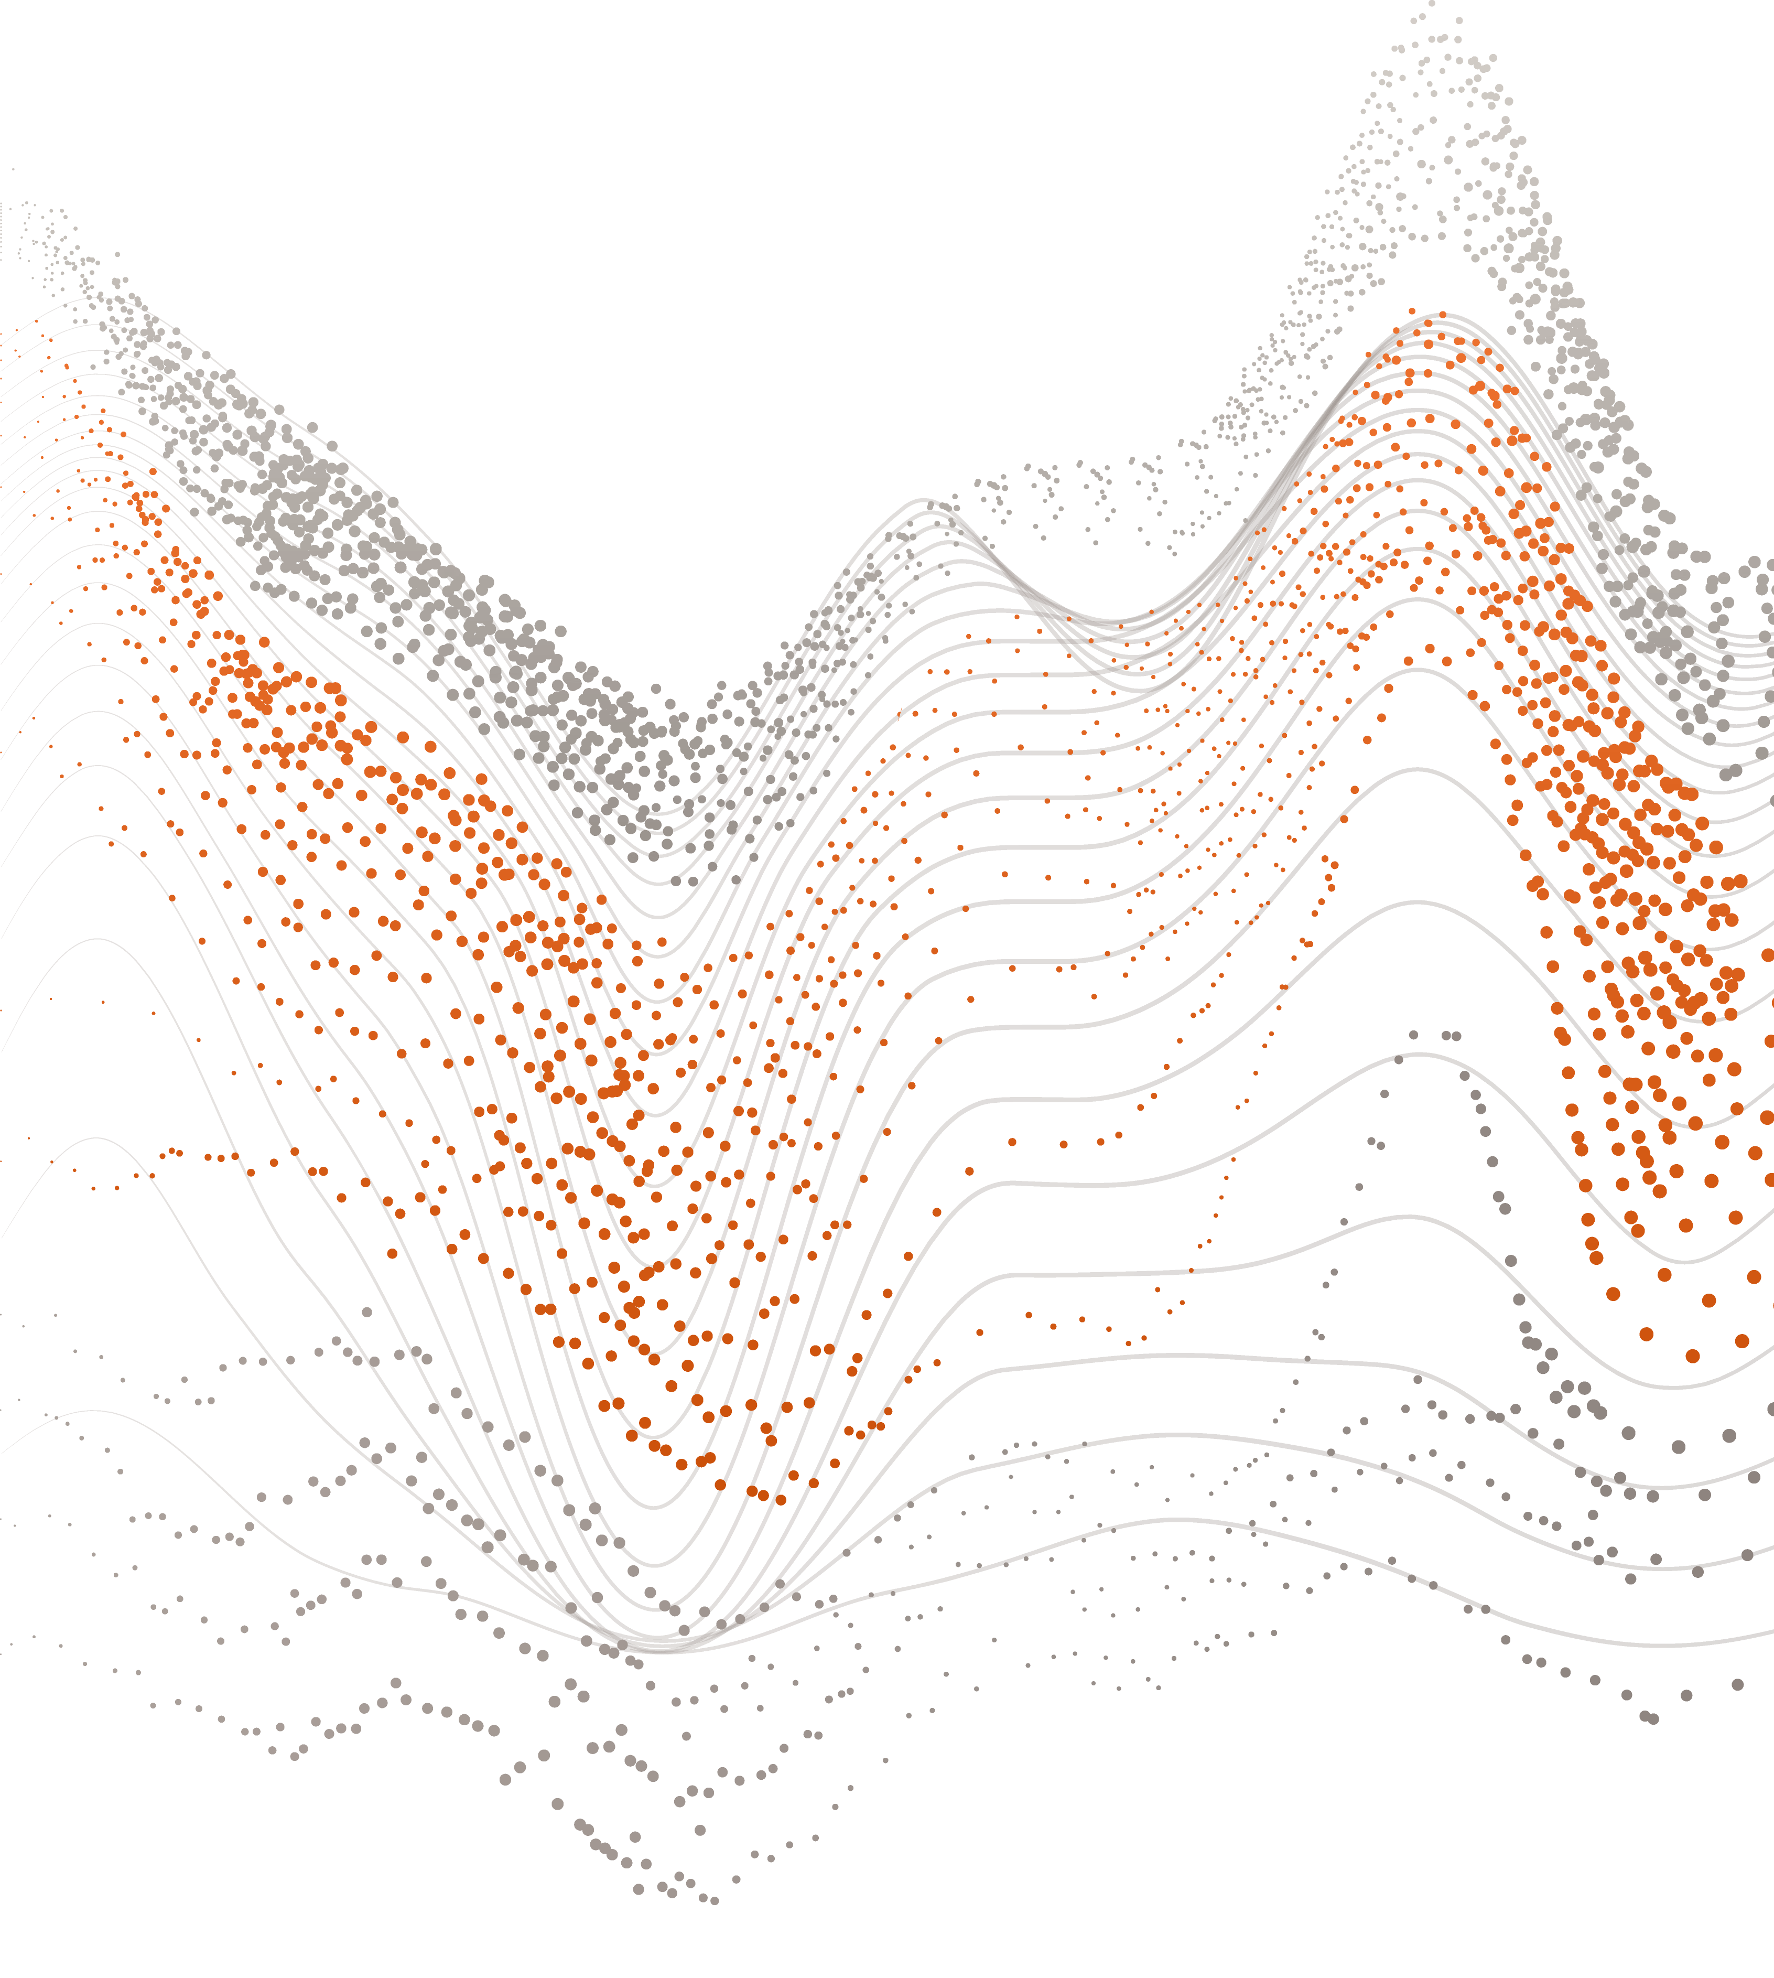
Conclusions : Key Takeaways
There is not one method that will fix all mode effects.
Variable-level adjustments requires each item have its own model
A model type may work well for one variable, but not another.
Models can be impacted by item-missing data in control variables.
Balancing act of decreased relative bias and increased variance.
Weight-level adjustments are still being explored

Slide 22
Conclusions : Limitations
We’ve only just begun exploring adjustments to mode effects.
Additional items to consider:
Only analyzed one mode sequence
Hundreds of variables to consider; none of which were continuous
Alternative regression models for categorical variables with three or more response categories
Classified based on overall mode, not question specific mode
Avoid mixed-mode ambiguity
Use paradata to be more specific by variable
Put these revised estimates in context with historical trends

Slide 23
Thank you.
Brian M. Wells, PhD
Senior Research Methodologist
wells-brian@norc.org

